Slide 1
COSC 323
Microprocessor Organization &
Introduction to Programming languages

Slide 2
Microprocessor Organization & Introduction to Programming languages
Outline:
Basic Microprocessor Structure and Function
Machine Language
Low-Level Language
High-Level Language

Slide 3
Microprocessor Organization & Introduction to Programming languages
Specific Objectives:
By the end of this module, you should be able:
Describe the Processor Organizations and explain the internal components.
Expatiate on how the sequential algorithm of the CPU execute each basic instruction.
Explain machine language, assembly language and high level language.
State advantages and disadvantages of machine language, assembly language and high level language.

Slide 4
Understanding the Processor Organizations
Processor Organization
The requirements placed on the processor or what it must do are:
• Fetch instruction: The processor reads an instruction from memory (register, cache, main memory).
• Interpret instruction: The instruction is decoded to determine what action is required.
• Fetch data: The execution of an instruction may require reading data from memory or an I/O module.
• Process data: The execution of an instruction may require performing some arithmetic or logical operation on data.
• Write data: The results of an execution may require writing data to memory or an I/O module.
To do these things:
The processor needs to store some data temporarily.
It must remember the location of the last instruction so that it can know where to get the next instruction.
It needs to store instructions and data temporarily while an instruction is being executed.
The processor needs a small internal memory known as the register to temporarily store instruction as depicted in the next figure

Slide 5
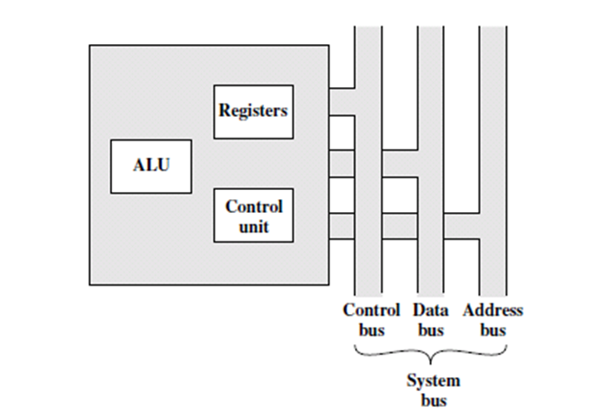

Slide 6
Arithmetic Logic Unit (ALU)
ALU has two main functions which are as follows:
• It performs arithmetic operations such as additions, subtractions, divisions and multiplications as the name suggests on a given set of data.
• All logical operations such as comparison of two sets of data based on specified relationships like greater than, less than, equal or greater than, equal or less than, equal to, etc and given parameters are carried out by this unit.
Therefore;
It is required that these data are fetched from the memory by ALU under the directive of the Control Unit at the beginning of every operation of ALU.
First, the data fetched is deposited into a register called Memory Data Register (MDR), which is located within ALU Later the same data is stored in another data registers called the Accumulators, which are also located within ALU.
Prior to the above process (normally referred to as Loading Data), the address of the data item would have been fetched from the Instruction Register (IR) to be located on Memory Address Register (MAR).
The complete process of how ALU carries out its functions is shown in the flow chart below

Slide 7
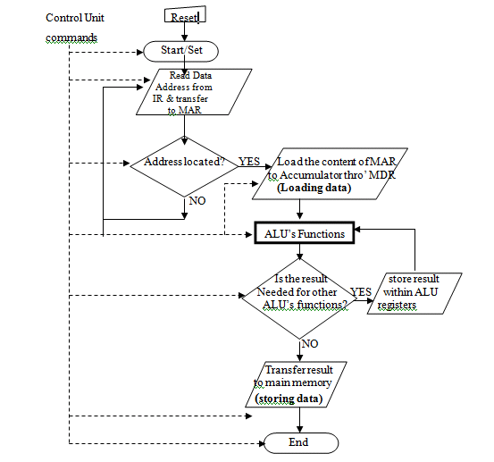
When the results of the operation of ALU are still required for further processing;
They are temporarily stored in data registers located within ALU hardware such as OPERAND, RESULT.
Otherwise, the results are sent to the main memory or computer output.
When the result is sent to the main memory, the process is called storing data.
Every step of ALU’s operations is directed by the Control Unit
Fig 7.2: Flow Chart for ALU’s Functions

Slide 8
Control Unit
The chief commander of any computer is its Control Unit (CU)
It is the nerve center of computer responsible for directing all computer operations from the inputs to the outputs.
No part of the computer hardware can function without a prior instruction/command from CU.
By so doing, the functions of every part of the computer are coordinated and synchronized just like the human body parts function in agreement with one another.
It determines what to do by interpreting the instructions and appoints which hardware does what is required.

Slide 9
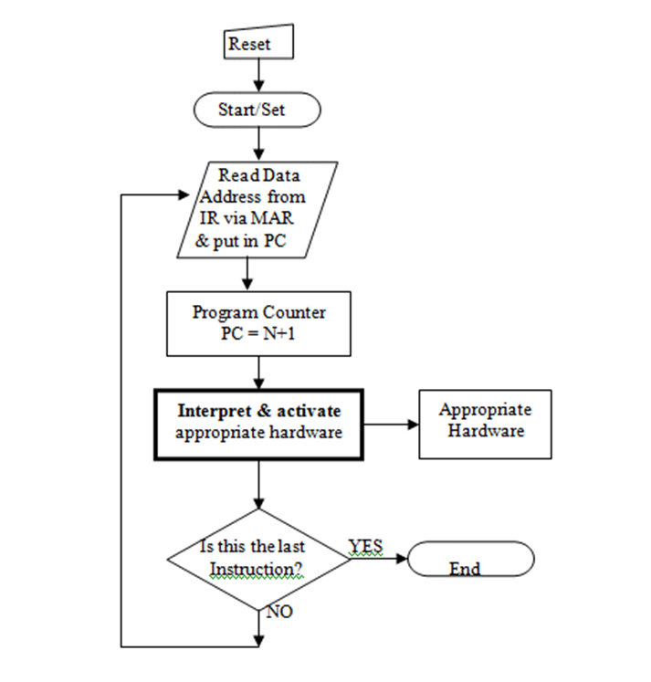
Computer is made to carry out its functions step-by-step through organized instructions, which are loaded into the main memory.
The instruction to be executed is transferred one-by-one from the main memory to the Instruction Register, IR via the Memory Address Register (MAR).
This happens when the main memory receives a signal from CU indicating the address of the instruction in the Memory Address Register (MAR) which is then moved as instructed.
The instruction in IR is interpreted by the Control Unit. The result of this interpretation causes CU to command the appropriate hardware to execute the instruction.
This process is repeated for the next instruction until the fetch-execution cycle is completed.
A register called Program Counter (PC) holds the address of the next instruction to be executed and for every instruction fetched, the content of PC is increased by one..
Fig 7.3: Flow Chart for CU’s Functions

Slide 10
The Register
The registers in the processor perform two roles:
• User-visible registers: Enable the machine- or assembly language programmer to minimize main memory references by optimizing use of registers. These are:
General purpose
Data
Address
Condition codes
• Control and status registers: Used by the control unit to control the operation of the processor and by privileged, operating system programs to control the execution of programs. These are:
Program counter (PC): Contains the address of an instruction to be fetched
Instruction register (IR): Contains the instruction most recently fetched
Memory address register (MAR): Contains the address of a location in memory
Memory buffer register (MBR): Contains a word of data to be written to memory or the word most recently read
These registers serve as input and output registers for the ALU and exchange data with the MBR and user-visible registers.

Slide 11
Bus Systems
A Computer Bus System is defined as a common pathway or channel between multiple devices. This internal bus of a computer also known as the local bus, host bus, or processor bus provides a parallel data transfer path between the CPU and main memory and to the peripheral buses
Three types of buses:
Address bus:
Is used to transport the source and destination addresses of information transmitted on the data bus.
Is also used to indicate memory locations generated by the microprocessor, bus master, or DMA.
The number of lines available to the address bus determines the address space
Data bus:
Is the internal pathway across which data is transferred to and from the processor or to and from memory.
The width and speed of the data bus directly affects performance and significantly influence system throughput.
The width of the bus is usually equal to the number of data pins on the microprocessor.
Control bus:
Is used to identify the type of bus cycle and indicate when the cycle is complete.
Is used to carry control signals, such as those needed to determine whether a device will read or write data and the operation being performed is to memory or I/O.

Slide 12
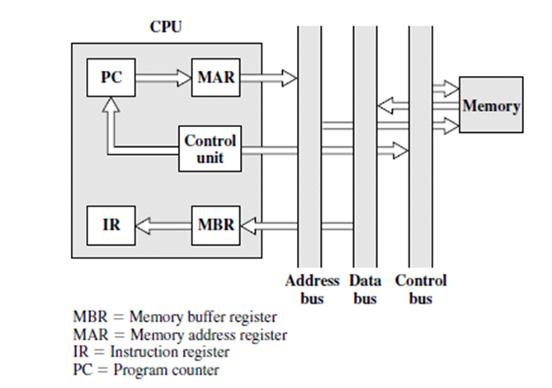
Learning how the sequential algorithm of the CPU execute each basic instruction
A typical sequential algorithm of how the CPU executes each basic instruction are as follows:
i. Fetch the next instruction from memory into the instruction register(IR)
ii. Change the program counter(PC) to point to the following instruction
iii. Determine the type of instruction just fetched
iv. If the instruction uses a word in memory, determine where it is
Fetch the word, if needed, into a CPU register
Execute the instruction
Go to (i) to start executing the following (next) instruction.

Slide 13
Introduction to Programming Languages
A programming language is a tool or template through which instructions are passed to computers
Programmers write instructions in various programming languages, some directly understandable by computers and others requiring intermediate translation steps.
Hundreds of computer languages are in use today. These can be divided into three general types:
a. Machine Language
b. Low Level Language
c. High level Language

Slide 14
Machine Language
Machine languages generally consist of strings of numbers (1s and 0s) that instruct computers to perform their most elementary operations one at a time.
Machine language is the “natural language” of a computer and such is defined by its hardware design.
Machine languages are machine dependent (i.e a particular machine language can be used on only one type of computer).
Advantages of Machine Language
i. It uses computer storage more efficiently
ii. It takes less time to process in a computer than any other programming language
Disadvantages of Machine Language
i. It is time consuming
ii. It is very tedious to write
iii. It is subject to human error
iv. It is expensive in program preparation and debugging stages

Slide 15
Low Level Language
In low level language, instructions are coded using mnemonics or symbolic codes such as DIV, ADD, SUB, MOV.
Assembly language is an example of a low level language.
An assembly language implements a symbolic representation of the numeric machine codes and other constants needed to program a particular CPU architecture.
The symbolic representation (called mnemonics) is usually defined by the hardware manufacturer and help the programmers remember individual instructions, registers, etc.
An assembly language is thus specific to a certain physical or virtual computer architecture (as opposed to most high-level languages, which are usually portable).
A utility program called an assembler is used to translate assembly language statements into the target computer's machine code.
Today, assembly language is used primarily for direct hardware manipulation, access to specialized processor instructions, or to address critical performance issues.

Slide 16
Low Level Language
Advantages of Low Level Language
i. It is more efficient than machine language
ii. Symbols make it easier to use than machine language
iii. It may be useful for security reasons
Disadvantages of Low Level Language
i. It is defined for a particular processor
ii. Assemblers are difficult to get
iii. Although, low level language codes are clearer to humans, they are incomprehensible to computers until they are translated to machine language.

Slide 17
High Level Language
High level language allows programmers to write instructions that look almost like everyday English and contain commonly used mathematical notations.
High level languages were developed in which simple statements could be written to accomplish substantial tasks.
Translator programs called compilers/interpreters convert high level language programs into machine language.
Advantages of High Level Language
i. Compilers are easy to get.
ii. It is easier to use than any other programming language
iii. It is easier to understand compared to any other programming language
Disadvantages of High Level Language
i. It takes more time to process in a computer than any other programming language
Question: Mention at least 10 high level languages you known.

Slide 18
Why learn Assembly Language?
Our focus in this course is Assembly language
We learn Assembly Language program majorly for the following reasons
If bugs have to be analyzed,
If the program executes different than designed and expected,
If the higher-level language doesn't support the use of certain hardware features,
If time-critical in line routines require assembly language portions,
If there is need for security
Others are:
Time-efficiency: Applications for which the execution speed is important fall under two categories:
Time convenience (to improve performance)
Time critical applications (to satisfy functionality)
Accessibility to hardware
Space-efficiency

Slide 19
Creating program in Assembler
To create a program in assembler different options exist
The DEBUGGER editor
The TASM or Turbo Assembler, of Borland
The MASM (Microsoft Assembler)
NASM (Netwide Assembler); supports a varieties of format including Linux & Microsoft windows.
Emu 8086 Assembler (Emulator 8086)

